Slide 1


Slide 2
Topic-Employees Pay Slip Generator
Team Members-
1)Suryansh RA2011003010103
2) Prakhar Kunwar Sinha RA2011003010093
3)Pulkit Sharma RA2011003010136
4)Aniket Mishra RA2011003010098
5)Shivam Singh RA2011003010087
6) Yashwant Kaushik RA2011003010135
7)Vivek Kumar RA2011003010070

Slide 3
USE CASE DIAGRAM-

Slide 4
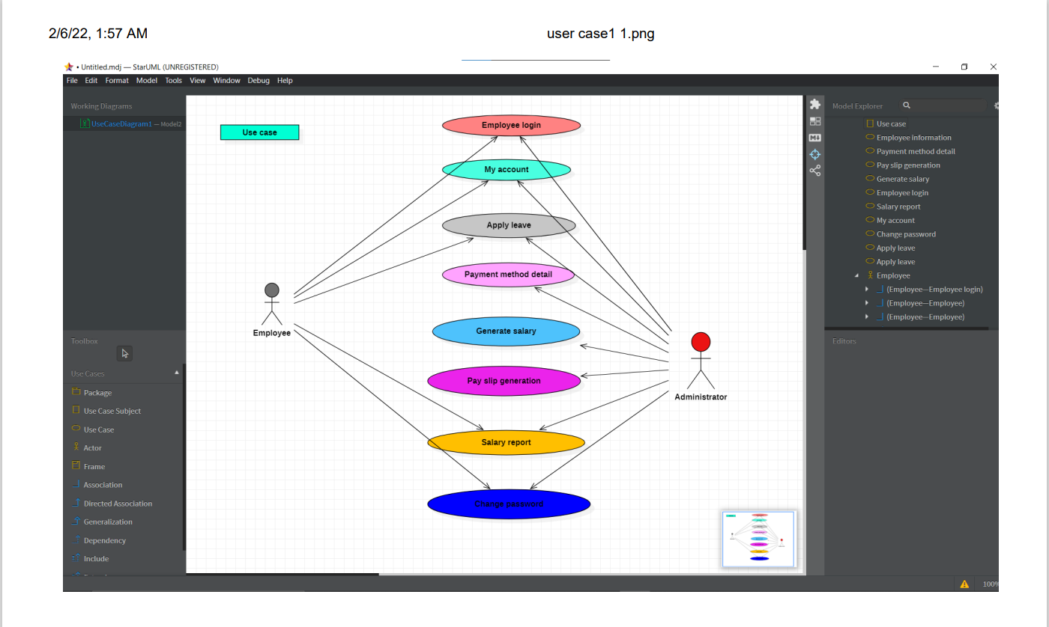

Slide 5
CLASS DIAGRAM-

Slide 6
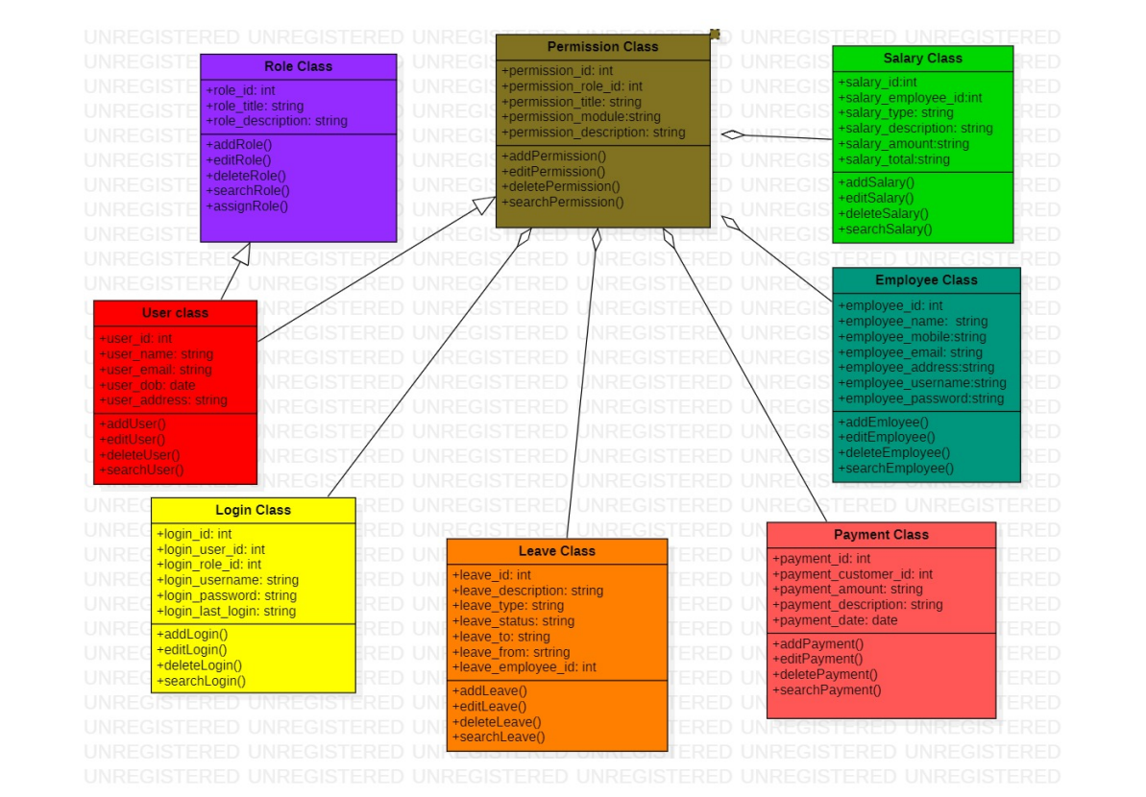

Slide 7
SEQUENCE DIAGRAM-

Slide 8
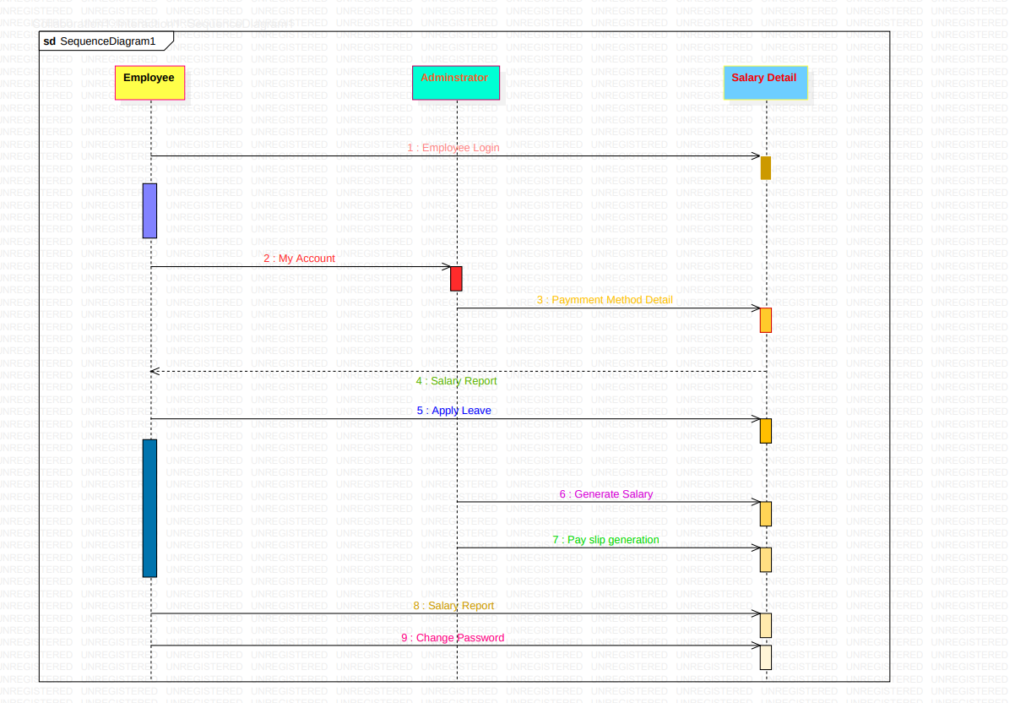

Slide 9
COLLABORATION DIAGRAM-

Slide 10
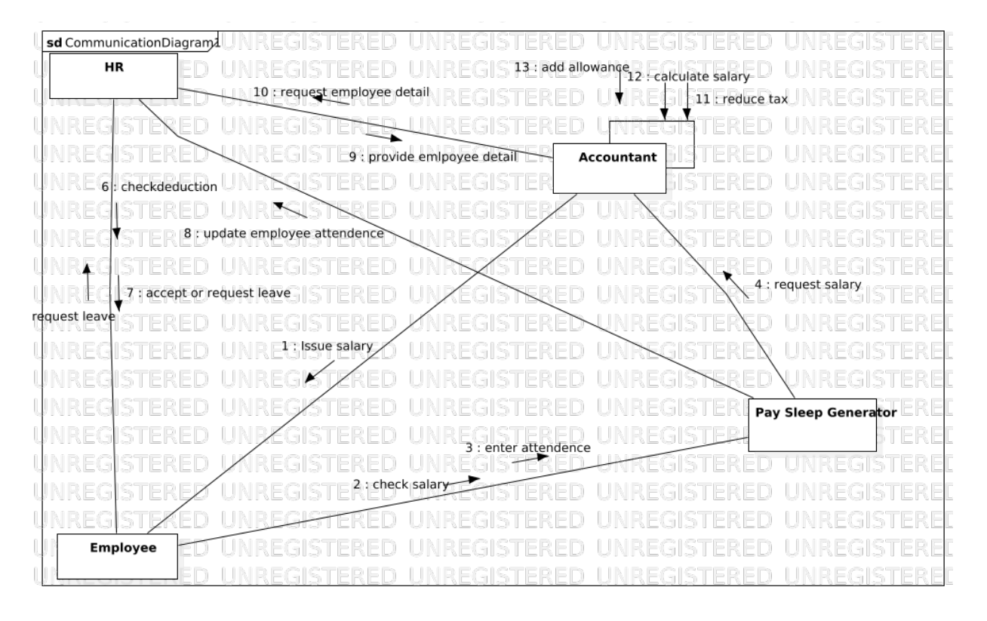

Slide 11
CODE-
#include<iostream>
#include<conio.h>
#include<stdio.h>
#include<fstream>
#include<string.h>
using namespace std;
void companyname()
{
system("CLS");
cout<<"\n\t\t\t\t\t\t\tDunder Mifflin Paper Company\n\t\t\t\t\t\t\t PAYROLL of December 2021\n\n\n";
}
class Employee
{
public:
string Name[20], Desg[20], id[20];
float workday, halfday, uninfoleave, payperday, bonus, number;
fstream mf;
void E_details(int j)
{
companyname();
cout<<endl;
string ddt[60];
fstream mf;
mf.open("codedata.csv", ios::in);
int x=j,y=0;
while(x--)
{
getline(mf,ddt[y],',');
cout<<endl<<"Enter The Details Of Employee "<<ddt[y]<<" : "<<endl;
getdata();
cout<<"Name -> "<<ddt[y]<<endl;
getline(mf,ddt[y+1],',');
cout<<"Designation -> "<<ddt[y+1]<<endl;
getline(mf,ddt[y+2],',');
cout<<"ID Number -> "<<ddt[y+2]<<endl;
P_details(ddt[y],ddt[y+1],ddt[y+2]);
y++;
}
mf.close();
}

Slide 12
void P_details(string Name, string desg, string id)
{
float x, y, z,m=0;
companyname();
cout<<"Employee : "<<Name<<"\nDesignation : "<<desg<<"\nID : "<<id<<endl;
cout<<"Pay Per Day -> Rs."<<payperday<<endl;
cout<<"Days Of Working -> "<<workday<<endl;
x=payperday*workday;
cout<<"Gross Payment -> Rs."<<x<<endl;
cout<<"Half Days -> "<<halfday<<endl;
cout<<"Un Informed Leaves -> "<<uninfoleave<<endl;
cout<<"%Medical Tax -> 2%"<<endl;
cout<<"%Social Security Tax -> 1.5%"<<endl;
if(payperday<1200)
y=400*halfday;
else
y=600*halfday;
cout<<"Half Day Deductions -> Rs."<<y<<endl;
z=300*uninfoleave;
cout<<"Un Informed Leave Deduction -> Rs."<<z<<endl;
cout<<"Bonus -> Rs."<<bonus<<endl;
cout<<"Net Deductions -> Rs."<<(x*0.02)+(x*0.015)+y+z<<endl;
cout<<"Net Payment -> Rs."<<x-((x*0.02)+(x*0.015)+y+z)+bonus<<"\n\n";
cout<<"Do you want to print details to a file?\n\t(1) Yes \n\t(0) No\n : ";
cin>>m;
if(m==1)
{
ofstream myfile;
myfile.open ("employee.txt",std::ios_base::app);
myfile << "---------------------------------------------------------------------------------------------------------------------------------------------------------------------------------------------\n";
myfile << " DUNDER MIFFLIN PAPER COMPANY\n";
myfile << " PAYSLIP December 2021\n";
myfile << "---------------------------------------------------------------------------------------------------------------------------------------------------------------------------------------------\n";
myfile << "NAME : "<<Name<<endl;
myfile << "Gross Salary : Rs. "<<x<<endl;
myfile << "Total Leave : "<<31-workday-halfday<<endl;
myfile << "Net Deductions : Rs. "<<(x*0.02)+(x*0.015)+y+z<<endl;
myfile << "Bonus : Rs. "<<bonus<<endl;
myfile << "Net Payment : Rs. "<<x-((x*0.02)+(x*0.015)+y+z)+bonus<<endl;
myfile << "---------------------------------------------------------------------------------------------------------------------------------------------------------------------------------------------\n";
myfile.close();
}
else if(m==0)
m=1;
else
cout<<"Error!";
}

Slide 13
void getdata()
{ cout<<"Pay Per Day : ";
cin>>payperday;
cout<<"Enter Total Number Of Working Days : ";
cin>>workday;
cout<<"Halfdays : ";
cin>>halfday;
cout<<"Number Of Un Informed Leaves : ";
cin>>uninfoleave;
cout<<"Bonus : ";
cin>>bonus;
cout<<endl<<endl;}
};
class emp : public Employee
{ public:
void E_details()
{ companyname();
string Name, Desg, id;
cout<<endl<<endl;
cin.ignore();
cout<<"Enter Name : ";
getline(cin,Name);
cout<<"Enter Designation : ";
getline(cin,Desg);
cout<<"Enter Employee's ID Number : ";
getline(cin,id);
getdata();
P_details(Name,Desg,id);
}
};
int main()
{
int i,j,k;
companyname();
cout<<"Enter The Number Of Emplyoees : ";
cin>>j;
Employee Ei;
emp ei;
companyname();
cout<<endl<<"(1) If you want to use data from file\n(0) If you want to enter a new Employee data\n: ";
cin>>k;
companyname();
if(k==1)
Ei.E_details(j);
else if(k==0)
{
for(i=1;i<=j;i++)
ei.E_details();
}
else
cout<<"Error";
return 0;
}

Slide 14
THANK YOU

